Slide 1


The World Federation of Pediatric Imaging
General Assembly
2018 – 2019 Report

Slide 2
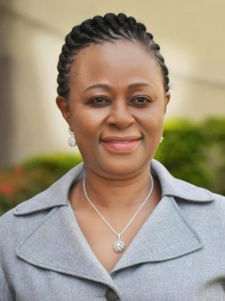
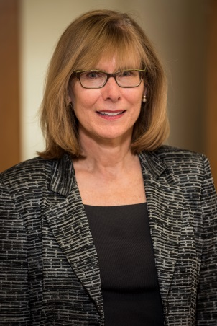

Council of Directors, 2018-2019
President: Omolola Atalabi (AfSPI)
Vice-President: Dorothy Bulas (SPR)
Past President: Wendy Lam (AOSPR)
Secretary: Jaishree Naidoo (AfSPI)
Vice-Secretary: Cristian Garcia (SLARP)

Slide 3
Council of Directors, 2018-2019
Treasurer: Richard Barth (SPR)
Vice-Treasurer: Tatiana Fazecas (SLARP)
5th Society Representative: Joanna Brown (ESPR)

Slide 4
Society Representatives, 2018-2019
AfSPI: Khaled Aboualfotouh Ahmad, Gladys Mwango
AOSPR: Timothy Cain, Kushaljit Singh Sodhi
ESPR: Martin Stenzel, Rutger Jan Nievelstein
SLARP: Pilar Dies, Alexandra Monteiro
SPR: James Donaldson, Diego Jaramillo

Slide 5
Committee Chairs
Education: Sanjay Prabhu
Outreach: Cicero Silva
  Incoming Chair : Hansel Otero
  Incoming co-chairs: Ricardo Faingold, Ramdas Senasi
TB Leader: Kushaljit Singh Sodhi
MRI Protocols: Michael Gee

Slide 6

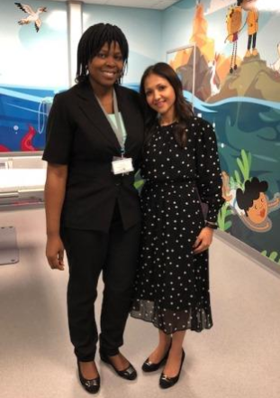
Achievements
Observership Program
  South Africa – Summer 2018 - Dr. Janet Akinmoladun, the first WFPI Observer/Fellow, pictured here (left) with her mentor at Nelson Mandela Children's Hospital in Johannesburg, South Africa, Dr. Jaishree Naidoo (right).

Slide 7
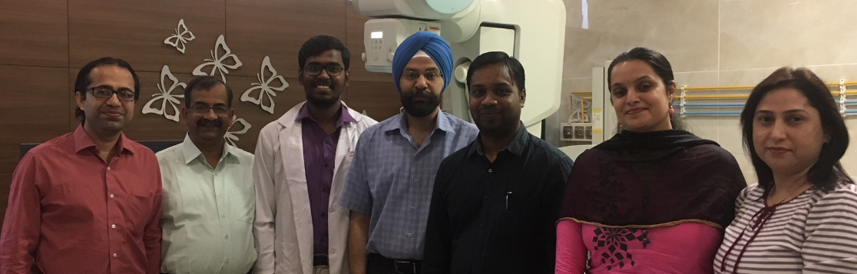
Achievements
  Observership in India – April 1 – June 30, 2019
  Dr Anitha Kini working under the mentorship of Professor Kushaljit Sodhi and colleagues.

Slide 8
Achievements
Observerships
  in Argentina – July 1 – September 30, 2019
    Under the mentorship of Jose Lipsich
  Observership in Philippines – August 1 – October 30, 2019
    Under the mentorship of Bernie Laya
Partnership with IAEA/ ESPR organizing education/workshops in dose reduction in Africa. One done already in Ghana, another planned for Kenya in near future and in SA early in 2020.

Slide 9
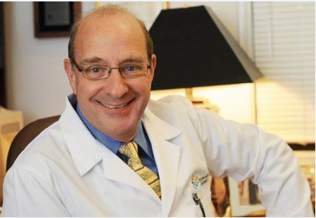
Support from the Shiels Memorial Foundation
We are honored to report that the William Shiels Memorial Foundation at Nationwide Children's Hospital has pledged 5 years of support for the WFPI Pediatric Radiology Observership Program.

Slide 10
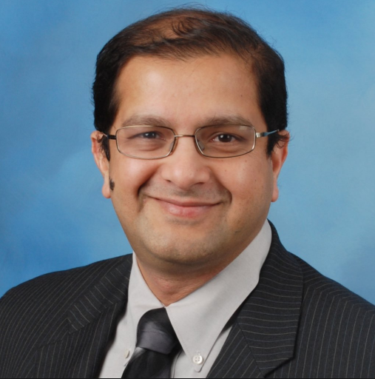
Education Project Report – Sanjay Prabhu
Jan 2018: Digital ambassadors introduced to WFPI education project
12 week plan to regularize case-based education on social media
Ambassadors from USA, Nigeria, & South Korea

Slide 11
Education Project Report
Next 3 Months:
  Website revamp
  Increase cases per week
  Collate digital ambassador cases into an e-book
  Add digital ambassadors from ESPR and SLARP
  Partnerships with other organizations
Next 6 Months:
  WFPI YouTube channel development
  Digital education for use of outreach teams

Slide 12
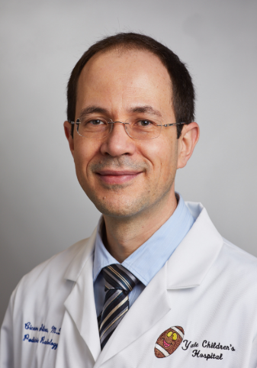
Outreach Activities - Cicero Silva
Teleradiology
Outreach trips
Partnerships
Events

Slide 13
Teleradiology
Telerad – 87 cases:
  40 from Maputo (Mozambique)
  42 From Zithulele (South Africa) (partnership w SASPI)
  5 from Lao Friends Children’s Hospital (Laos)
Telerad cases now on fully automated allocation, reducing time for final reporting. By most recent metrics (March 2019) median answer delay was 2.9 hours (min 0.6h, max 11.5h)

Slide 14
Outreach Trip
Mozambique:
Ricardo Faingold followed -up outreach visit to Maputo in July 2018 (partnering with UCLA Global Health Project):
Interactions with radiology residents, neonatologists, pediatricians, surgeons and radiologists
A total of 11 lectures and case show sessions, as well as clinical, surgical, PICU and radiology rounds; case discussions and consultations held daily
Bedside ultrasound exams; workshops on neonatal US (at the NICU) and on FAST (at the PICU)

Slide 15
Partnership Opportunities
….with the Global Initiative for Children Surgery (GICS)
This group was recently formed by pediatric surgeons "to address previously overlooked children’s surgical issues and to bring together providers and implementers of surgical services for children with health, advocacy, and policy experts to analyze the current state of surgical care for children in low- and middle-income countries (LMICs).
WFPI has assembled a team of pediatric radiologists from Brazil, India and Mexico, who are leading the GICS Radiology Workgroup, and have developed imaging recommendations that have been included in the GICS document "Optimal Resources for Children's Surgical Care", which is in press.

Slide 16
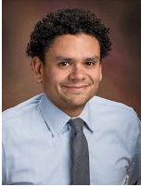
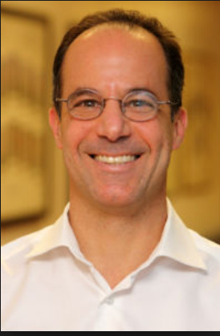
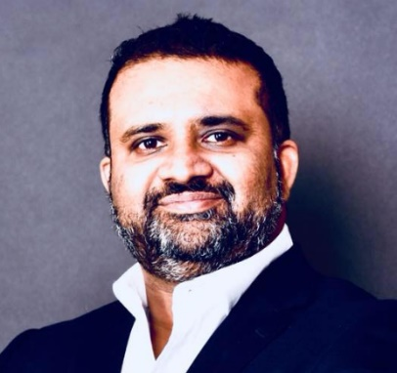
Leadership Succession
Hansel Otero - incoming Outreach Chair for 2019-2021 term
Ricardo Faingold and Ramdas Senasi appointed co-chairs for the same term.
Hansel Otero, MD Ricard Faingold, MD Ramdas Senasi, MD

Slide 17
Outreach Goals for 2019 forward developed by incoming team led by Dr. Hansel Otero
Increase the number of cases/sites using our teleradiology platform
Develop an introductory document/invitation to use the platform for all WFPI members to distribute among the sites that we are currently assisting with in-person outreach
Recruit new teleradiology platform coordinators
Recruit more tele readers as the demand increases
Increase the visibility of WFPI outside radiology
Presentations at AAP in 2019 and in 2020
Possible collaboration through the surgical subcommittee of the Section on International Child Health
Further develop relationship with Reach out (again) to GICS
RSNA Abstract

Slide 18
Outreach Goals for 2019 forward
Accessible Education
Work with Website/Education Chair Sanjay Prabhu to organize educational content in the webpage and to generate a “portable” educational portfolio
We are almost done with a “travel kit” of 60 basic lectures from CHOP. Same concept.
Lectures/material already in the website. Just curate it in a different way and make it downloadable/portable to not depend on the internet when traveling
PAHO/WHO has interest in developing an international QA/QI curriculum and deployed within this fiscal year (before 3/2020). We should be partners in developing the curriculum as well as basic SOP/QA manual.

Slide 19
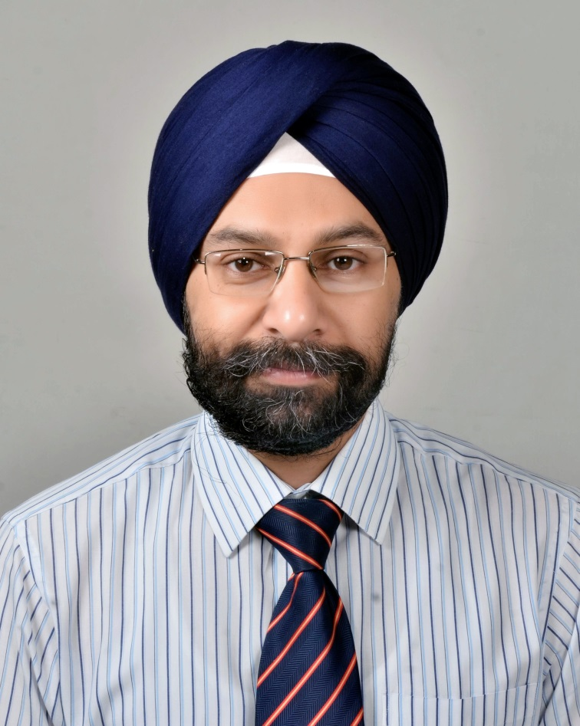
TB Group – Kushalijt Sodhi
TB Hotline
Reformation of TB Group
Interesting Cases – TB
Events

Slide 20
TB Group Update
New TB Hotline of TB readers and moderators formed as a WhatsApp group: This has been done to speed up the reporting time
Preliminary results have been excellent.
TB group will be reconstituted following the SPR meeting.
We have interested volunteers who will be added.

Slide 21
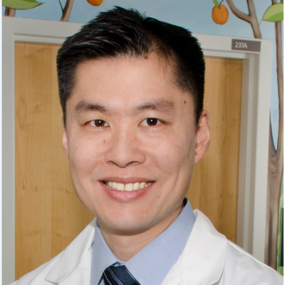
MRI Protocol Committee – Michael Gee
Partnership with MRI reps from Siemens, GE, and Philips
Development of 11 standardized WFPI MR protocols:
Rapid brain
Seizure brain
Hydrocephalus brain
Tumor/infection brain
Short abdomen
Long abdomen
  Chest-abdomen LN screen
  Whole body MRI
  Rapid spine
  Tumor/infection spine
  Osteomyelitis/long bone

Slide 22
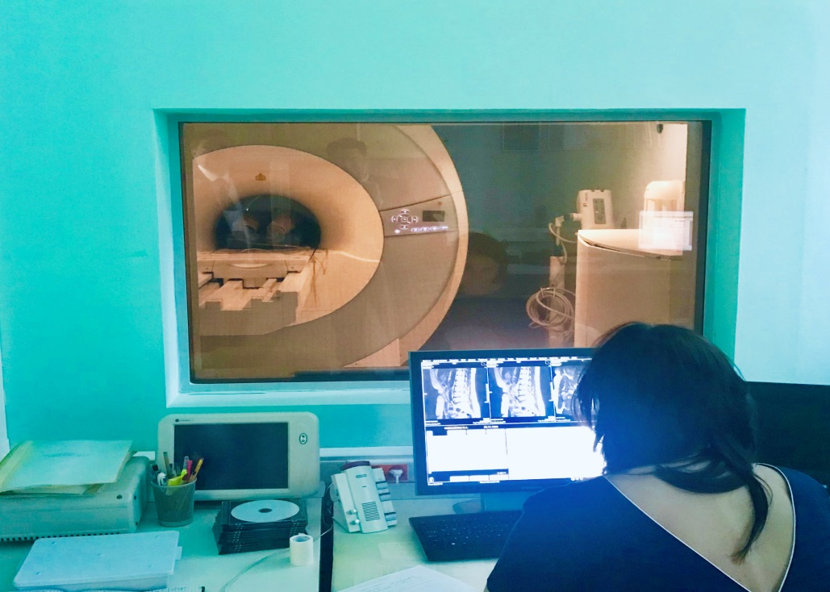
MRI Protocol Committee – Michael Gee
Identification of early adopter WFPI protocol sites:
  Red Cross Hospital: South Africa
  Garrahan Hospital: Argentina
  Fundacion Cardioinfantil: Colombia
  Almazov Medical Center: Russia
  Hospital Infantil: Mexico
  Hospital Clinico: Chile
  DC Children's National: USA
  MGH: USA
Next steps:
  Publish protocols on WFPI website
  Feedback from adopter sites

Slide 23

Finance Report Summary – Richard Barth
All income since 2011 : $396,510.23
All expenses since 2011: $199,124.25
  Administrative, Website and Observership
Positive balance: $197,385.98
  Restricted fund created
  New pledge of $12K annual support from Shiels Foundation

Slide 24
2019 – 2020 Leadership
Dorothy Bulas, President – (SPR)
Joanna Kasznia-Brown, Vice President - (ESPR)
Cristian Garcia, Secretary – (SLARP)
Treasurer - Richard Barth (SPR)
Tatiana Fazecas , Vice Treasurer (SLARP)
Omolola Mojisola Atalabi, Past President (AfSPI)
Jae-Yeon Hwang, 5th Organizational Representative (AOSPR)
M. Ines Boechat, Founding President (SPR)

Slide 25

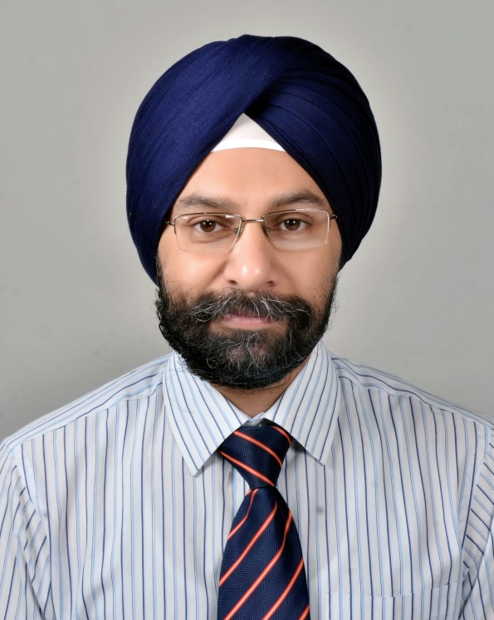
WFPI Leaders named
Honorary Members@ SPR 2019
Monica Atalabi, MBBS, FWACS, FMCR, MBA Kushaljit S. Sodhi, MD, PhD, MAMS, FICR

Slide 26
Thank you!

